Slide 1


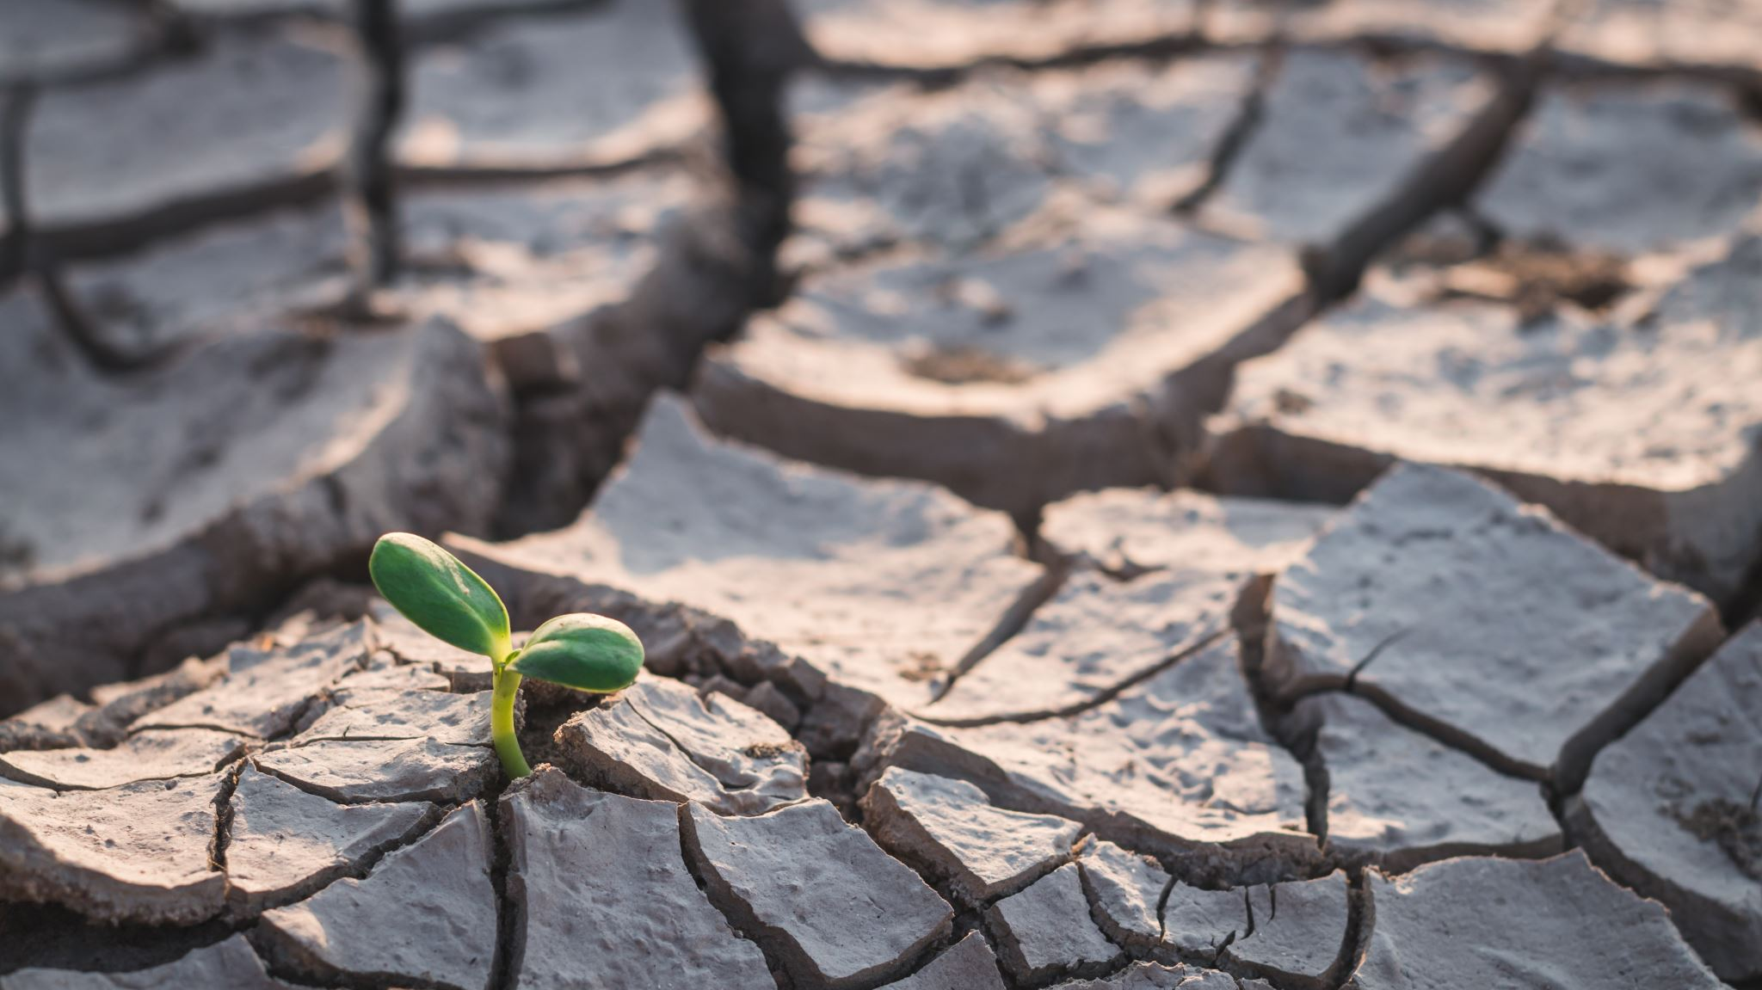
Floods and poverty
Brett, Traeger, :

Slide 2
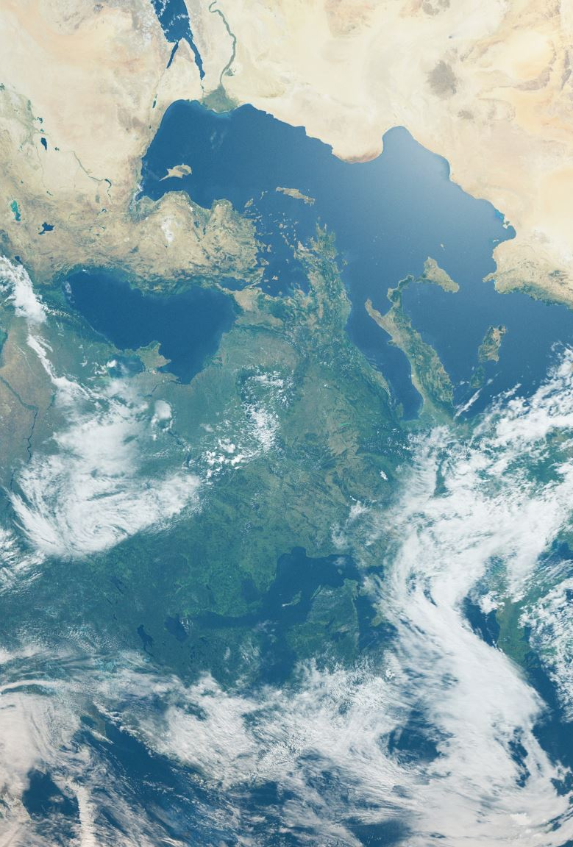
What we seek to analyze
Which regions in the United States experience the highest per capita poverty rates?
Which U.S. regions are most affected increasing climate events, specifically floods?
In which areas of the U.S. are the economic impacts of these climate disasters the greatest?
Upon examining our three primary datasets, what correlations or patterns emerge? Are there specific regions that exhibit elevated levels of all of these issues

Slide 3

Poverty in the US

Slide 4
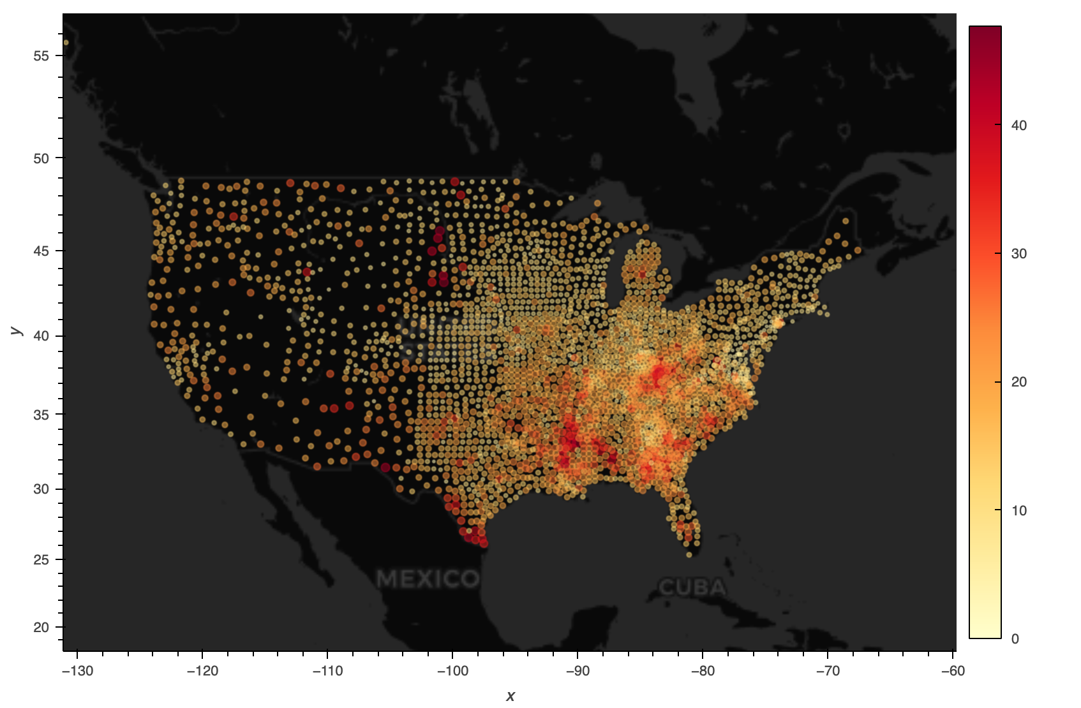
visualization 1: how does poverty look across America?
It picks up a higher density as you move east
There is an increase frequency in south easter us and along the southern Appalachian mountain region.

Slide 5
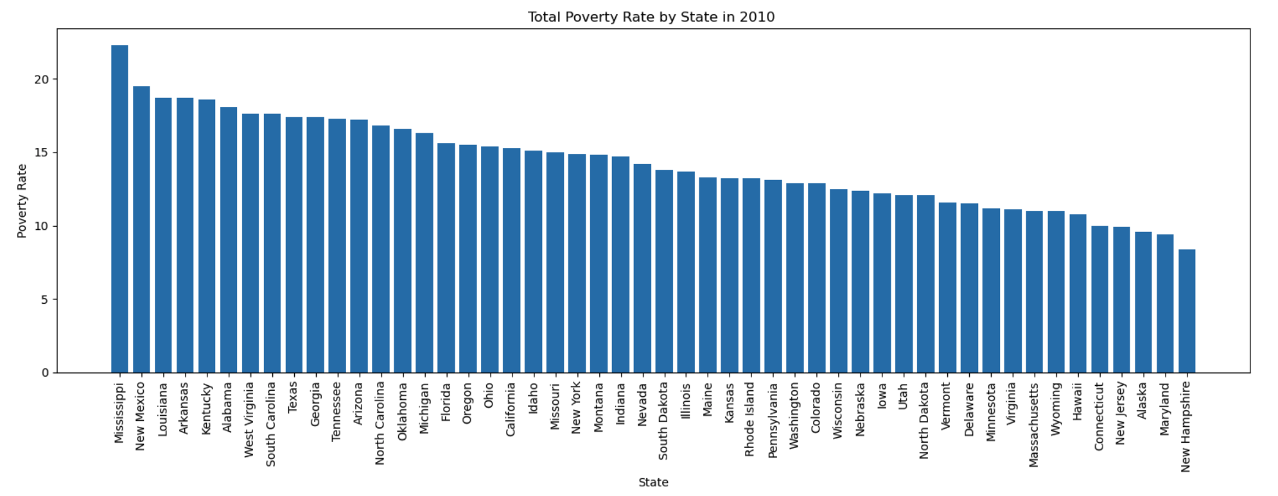
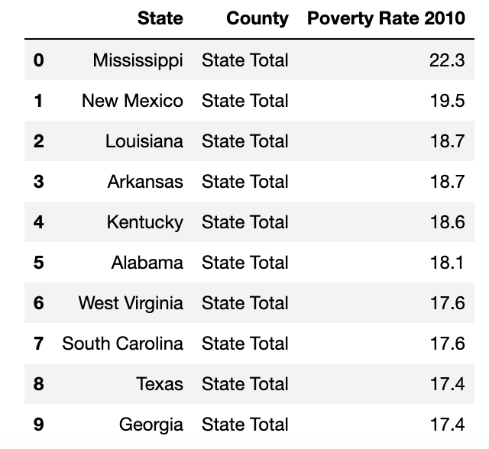
What are the states with the highest poverty rates?

Slide 6
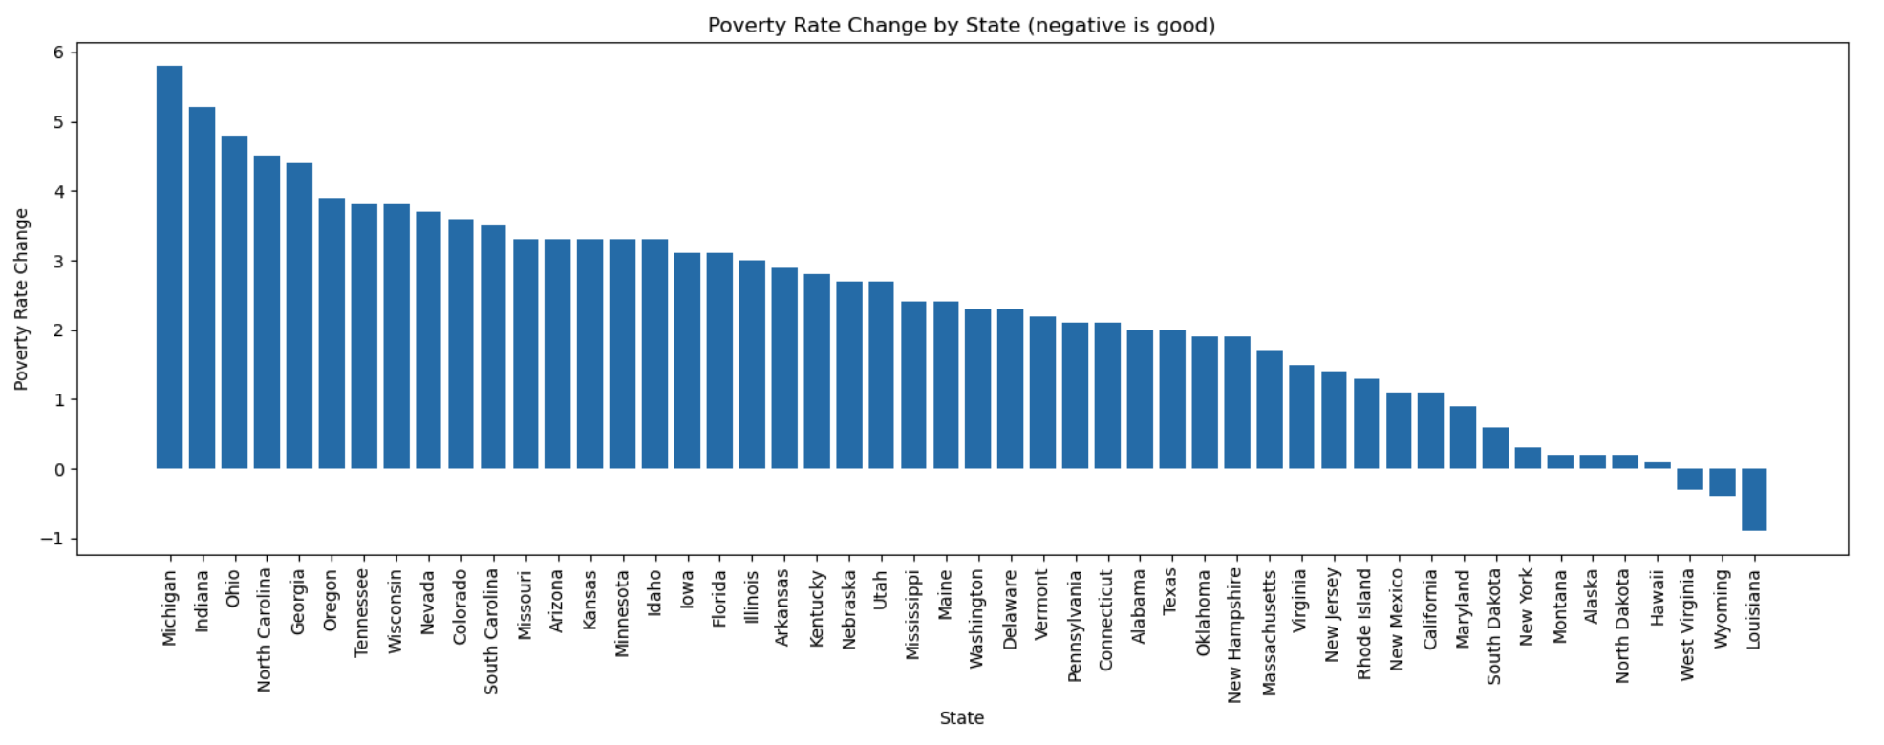
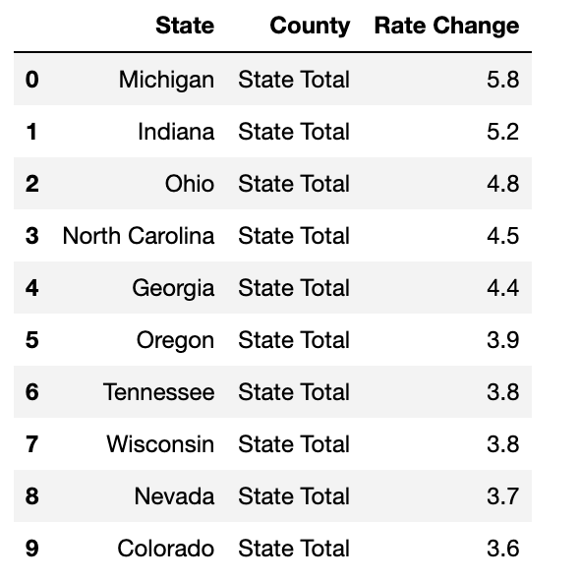
Poverty Rate Change last ten years

Slide 7
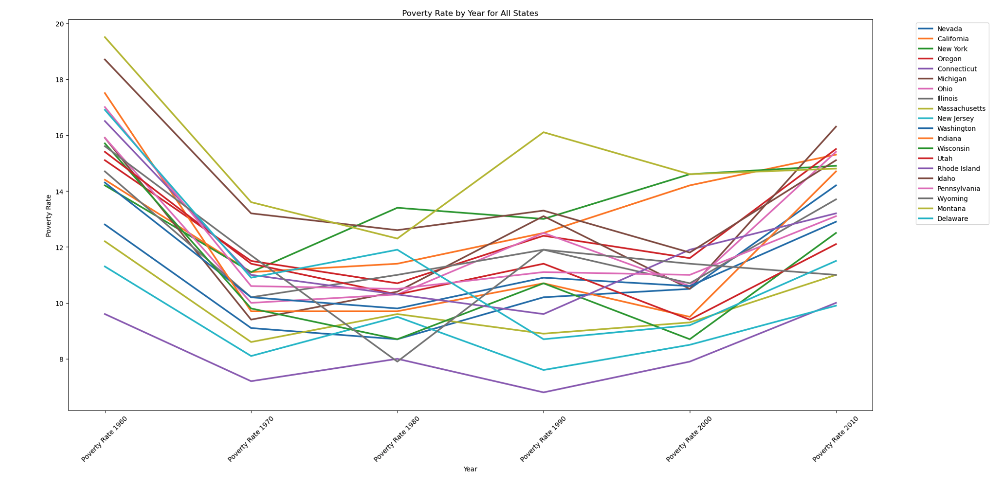
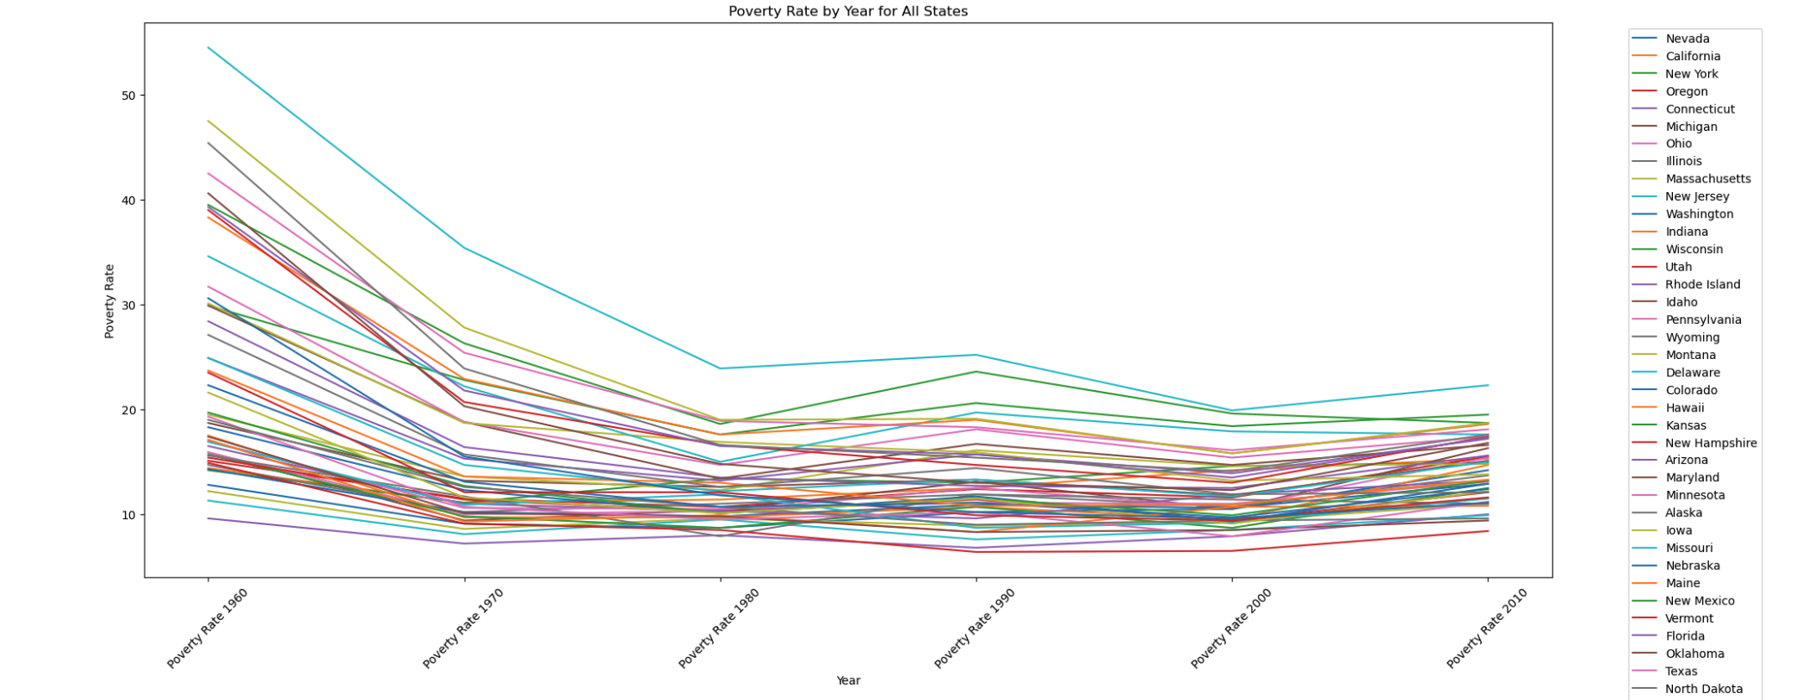
How the state poverty rates look over time

Slide 8
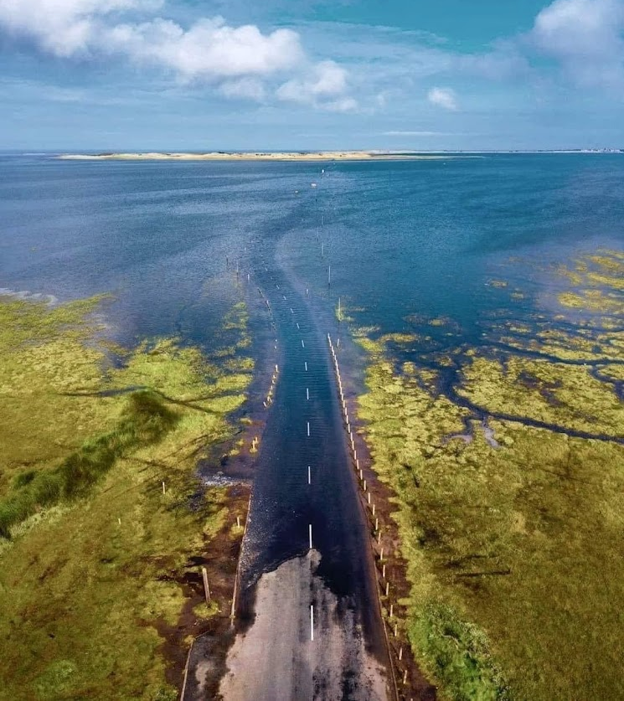
Flooding. Who Is it good for?
Absolutely, absolutely no one.

Slide 9
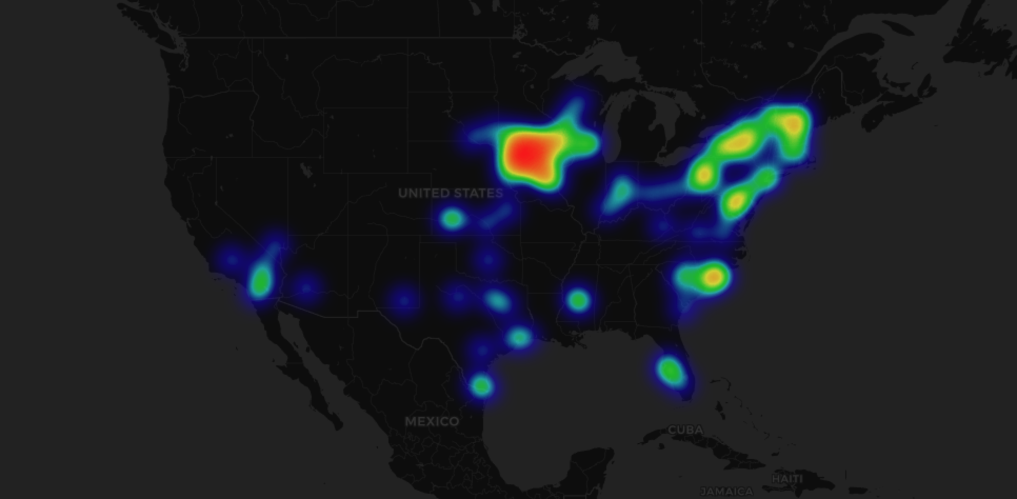
Visualization 2: where has flooding increased the most?

Slide 10
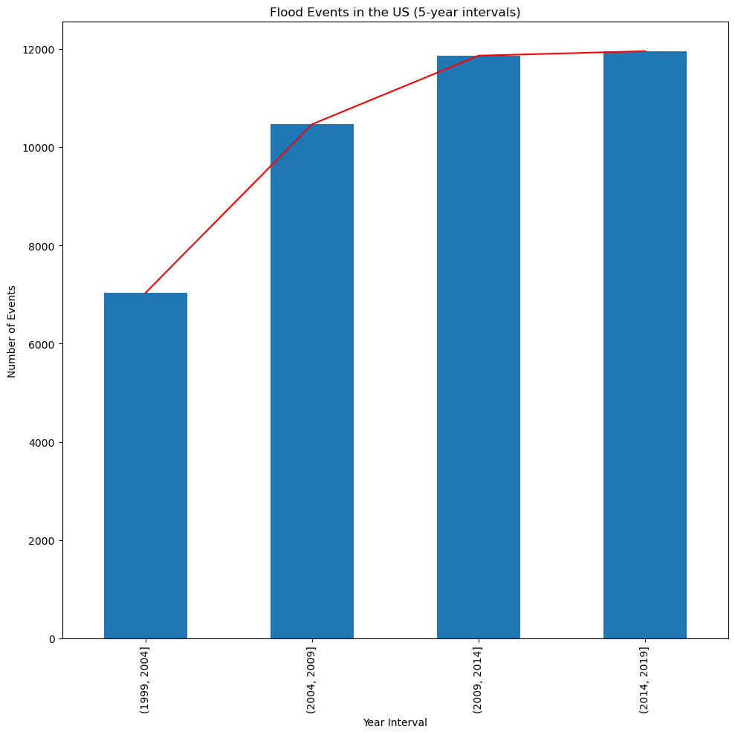
Flooding across the US is Increasing

Slide 11
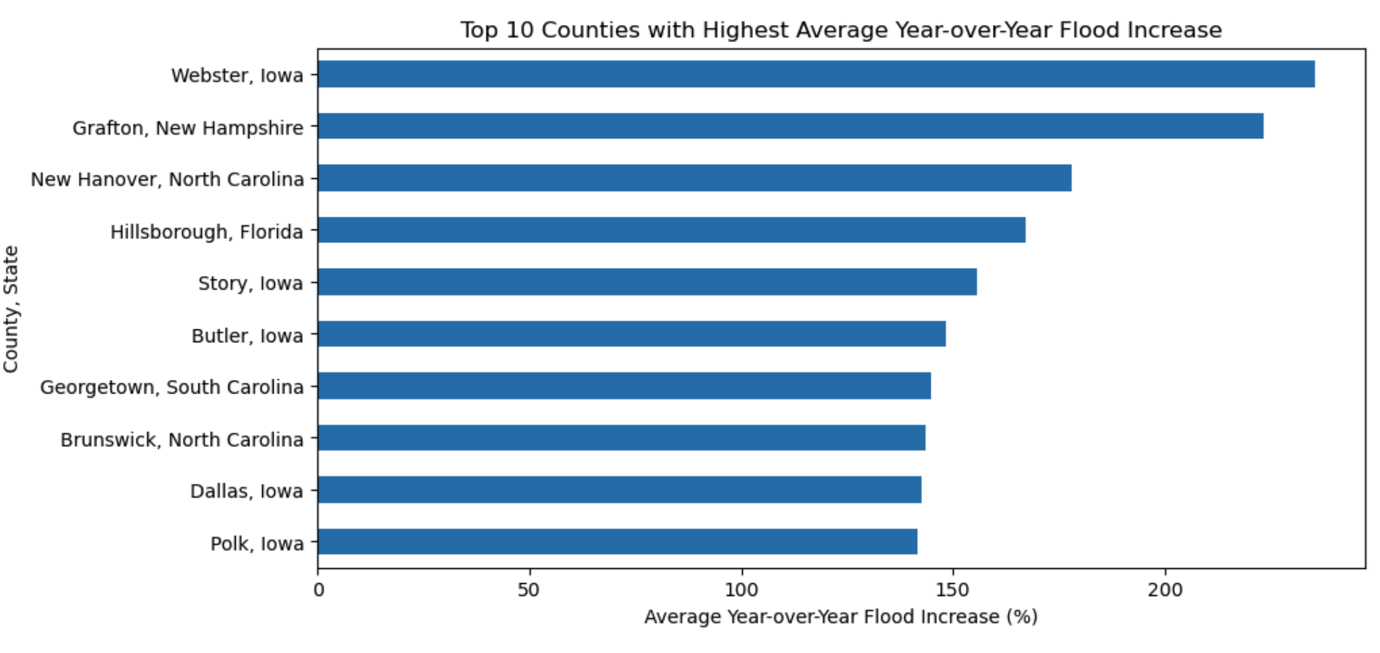
Visualization 4: Where is it increasing the most
The Unfortunate Winner is IOWA

Slide 12
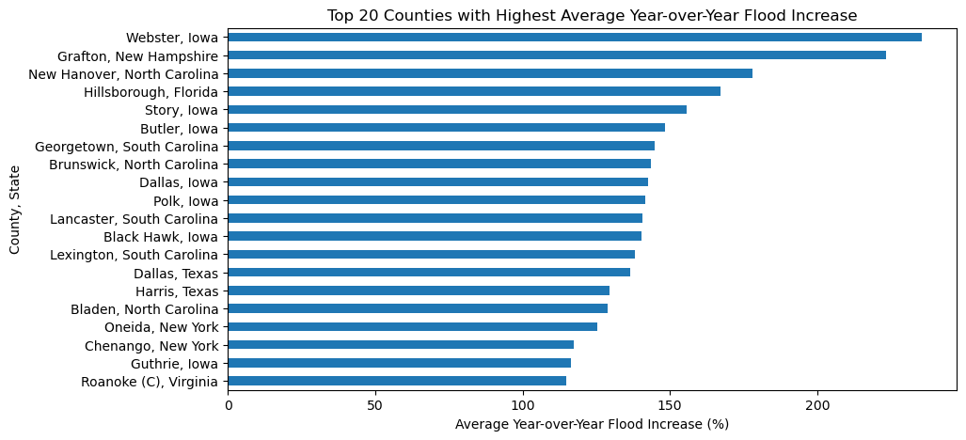
And when we zoom out further the predominance become even more clear

Slide 13
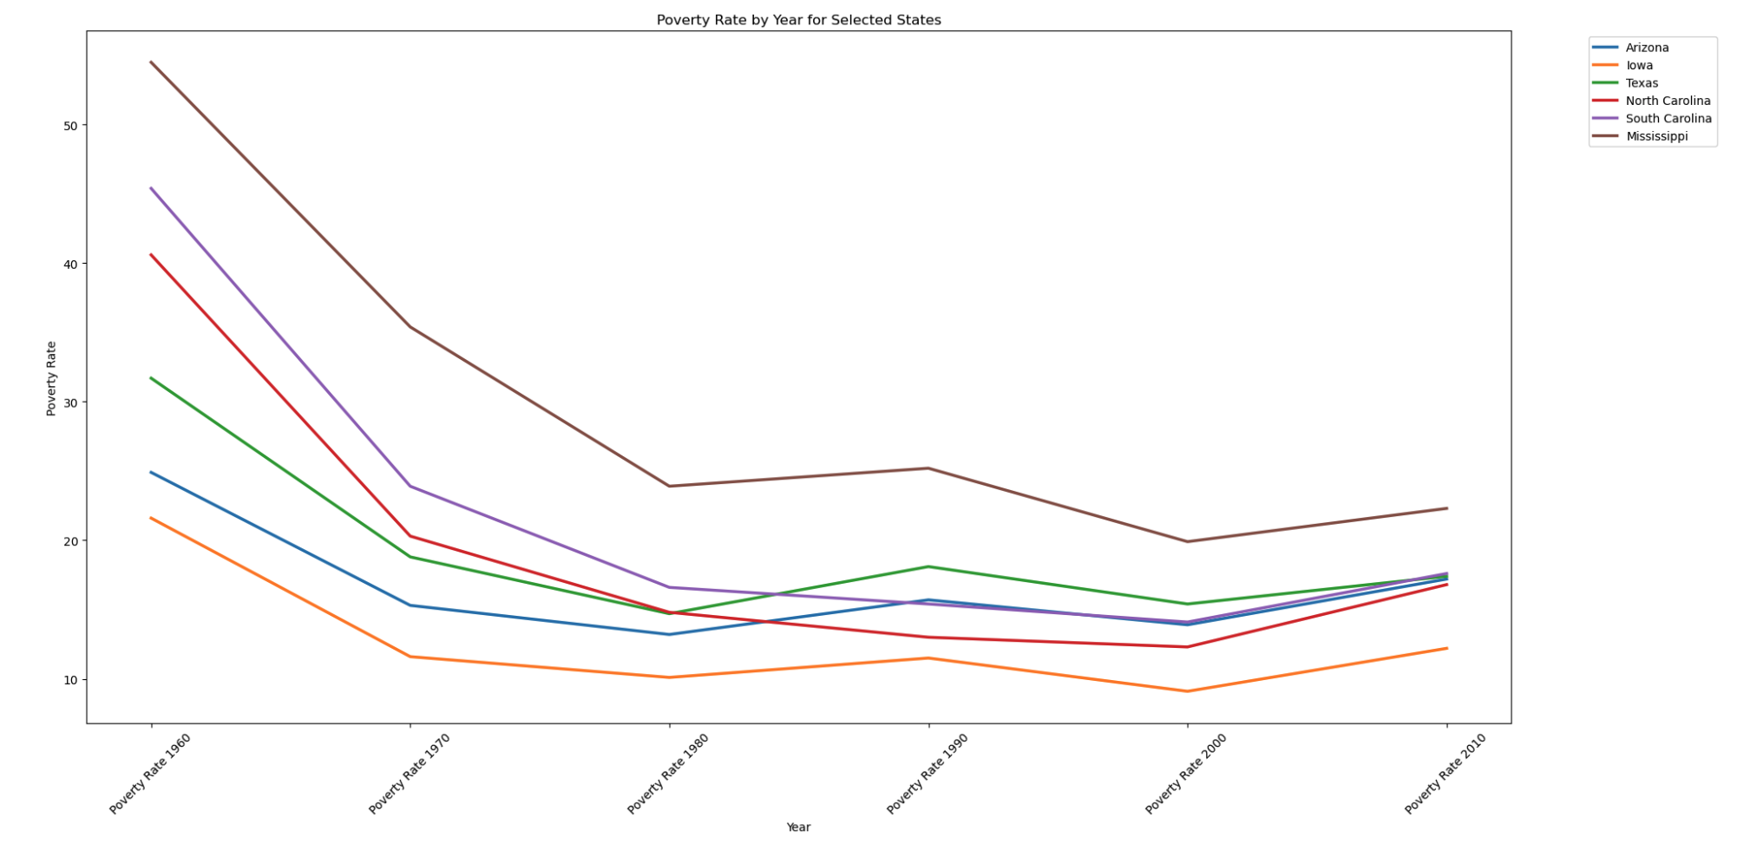
These areas are also seeing an uptick in poverty

Slide 14
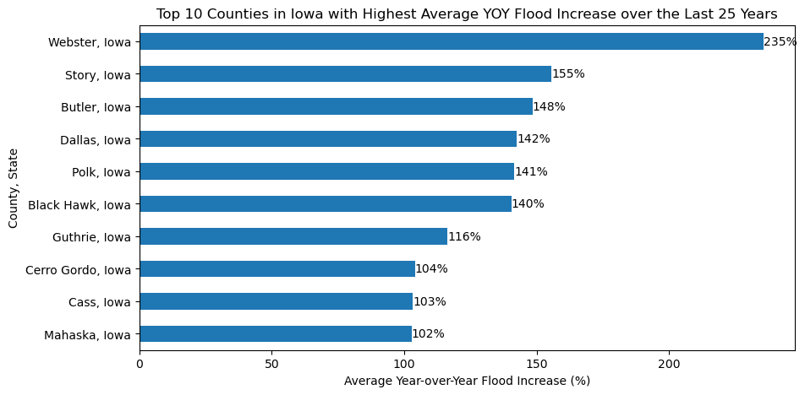
Visualization 5: how much is flooding Increasing across Iowa?

Slide 15
How do our heatmaps look when overlayed

Slide 16

The Damages

Slide 17
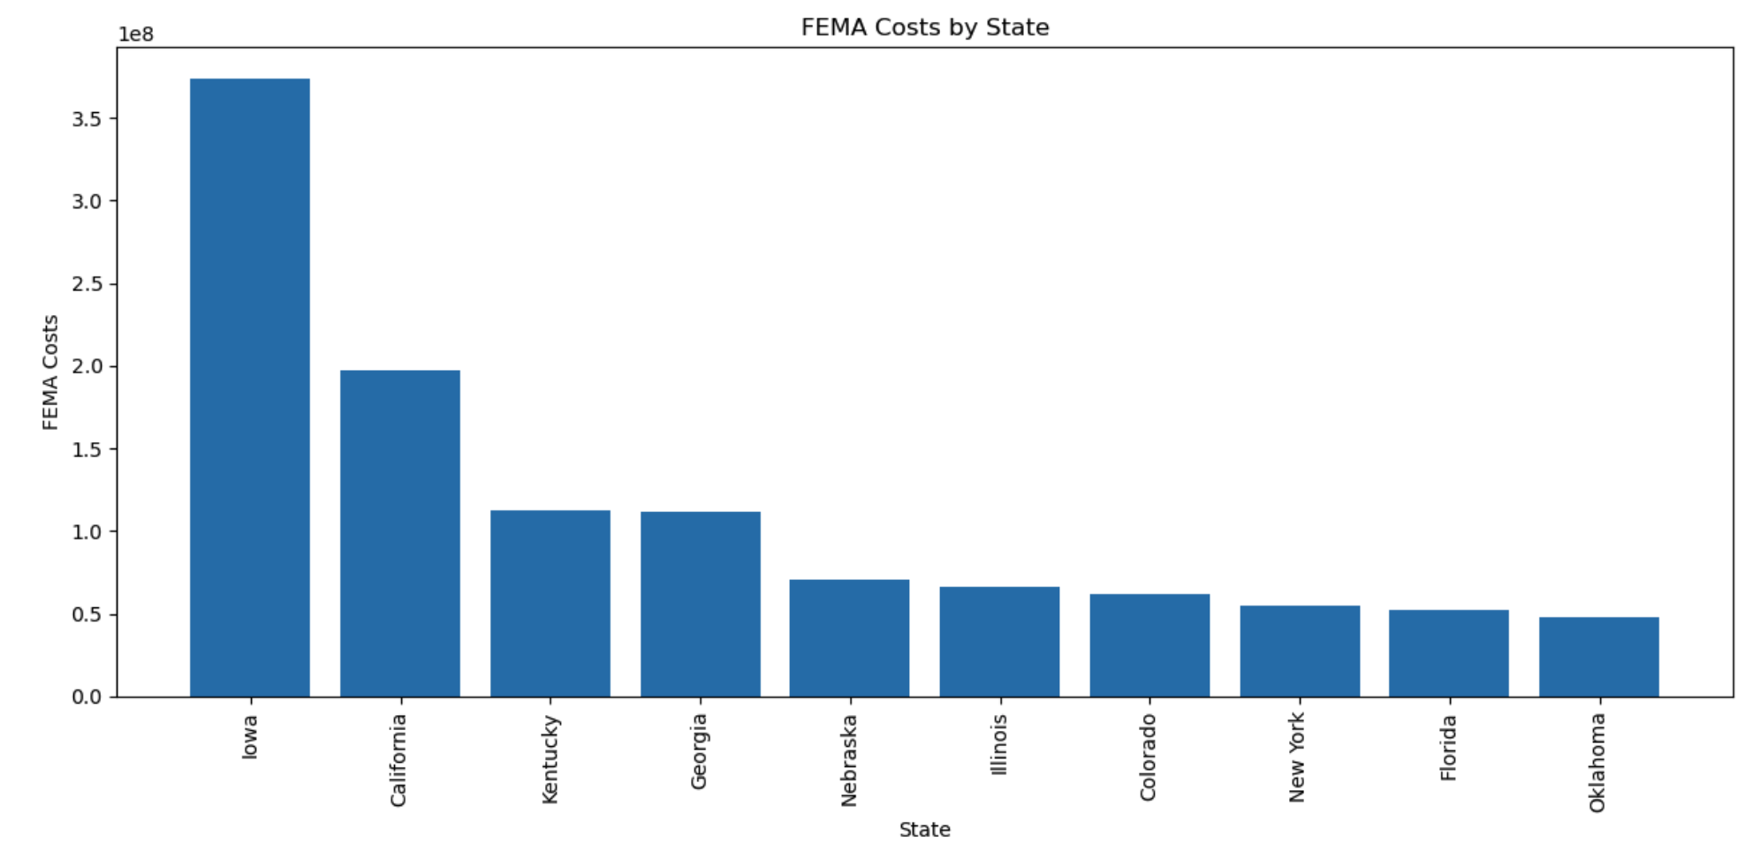
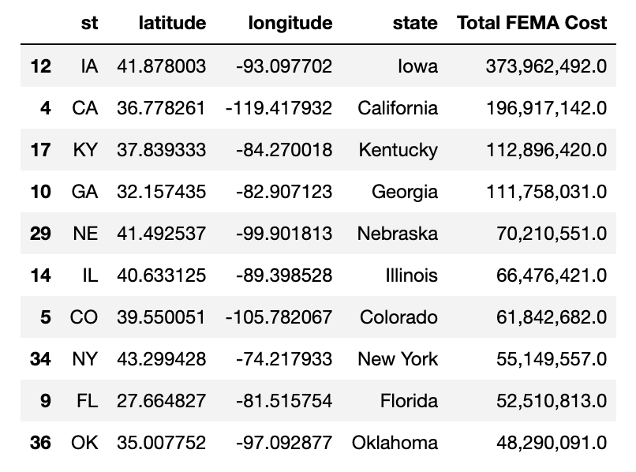
FEMA flood Costs per state
What is the Cost of all this Flooding?

Slide 18
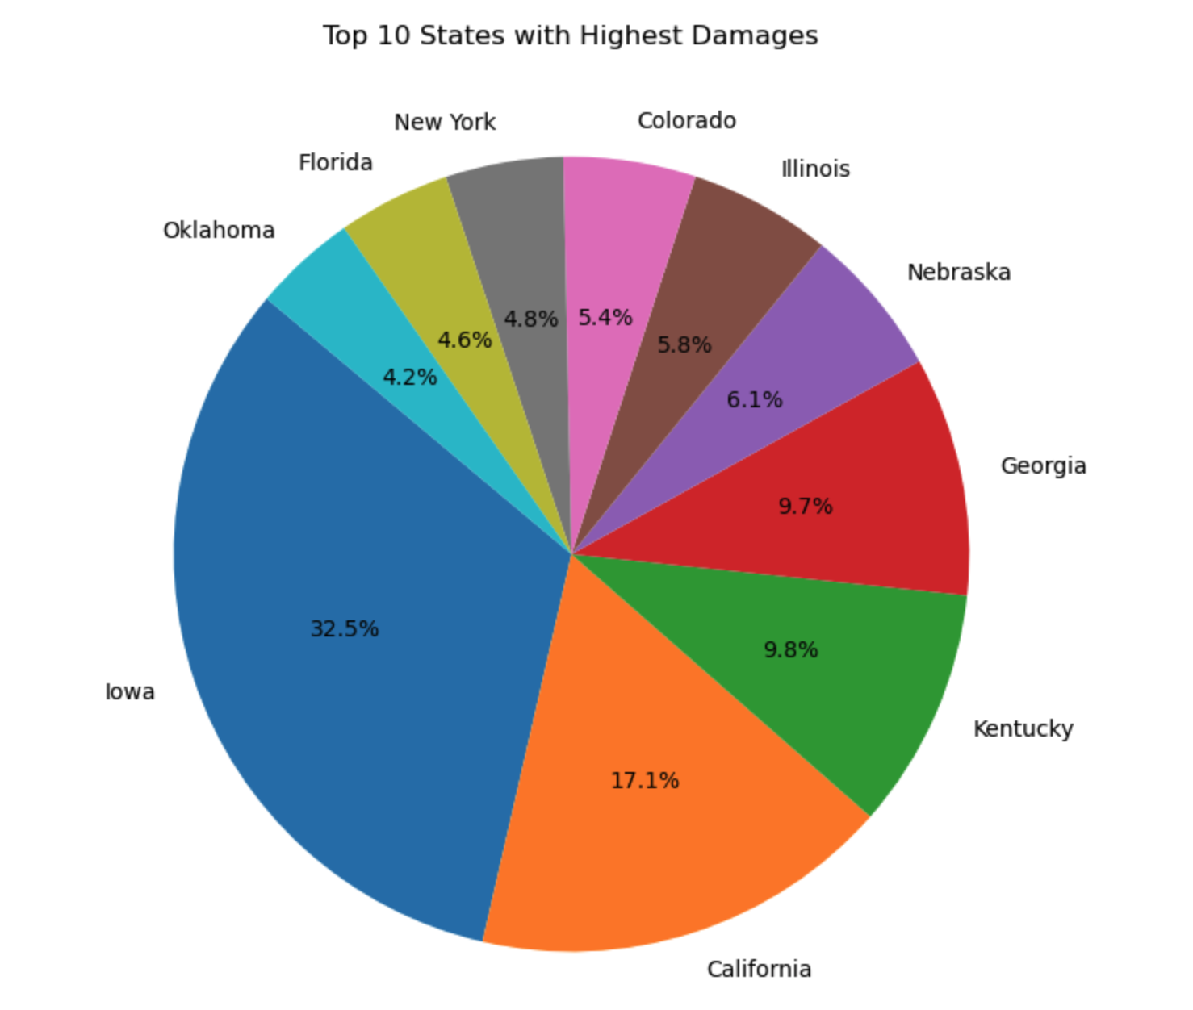
Visualization 8
According to FEMA flood cost data, Iowa is clearly the highest costing state at nearly twice that of the next largest.
California being one of the largest states by area makes the comparison even more drastic.
Were also seeing some of the states identified in the high poverty analysis

Slide 19
Final Take aways: what did we find
Trends
Poverty has sustained for the past 50ish years but is beginning to slowly rise
Flooding events have consistently increased in the past 25 years
Hot spots to look out for
Iowa has experience enormous change in the amount and damage of floods
They have not had to deal with this in the past and may be less prepared
Areas with high poverty such practically the south east of the country are also seeing an increase in flood frequency and intensity. They will have less means to deal with the damages.

Slide 20

Datasets used, methodology
Datasets:
Flood events in the US from NOAA
Poverty rates across the US from DATA.GOV
County FIP code shapefile from DATA.GOV
API
Natural Disaster spending from FEMA
Methodology
Python data analysis using pandas, numpy, matplotlib, folium maps.
Creating charts and heatmaps based on collected data

Slide 21

fin

